Slide 1



Cloud Native Enterprise
Microservice Architectures in the Enterprise with Spring and Cloud Foundry
Notes:
Resting slide on screen before you begin presenting.

Slide 2
Agenda
Why?
What?
How?
Notes:
I wanted to go over some of these emerging development models and
how tech companies have been successful in moving to these highly composable, resilient application architectures that we’re referring to as cloud native applications.
I want to show you what kind of platform tools the leading tech companies had to build.
And how these new designs are really hitting a lot of enterprises, companies that don’t depend on software directly.
We also want to showcase how these projects work together with a demo of a microservice-based Java app, built with Spring Boot and Netflix OSS projects
Before we turn it over to discussion

Slide 3
WHY
Notes:
Now I’d love to open this up for discussion.

Slide 4
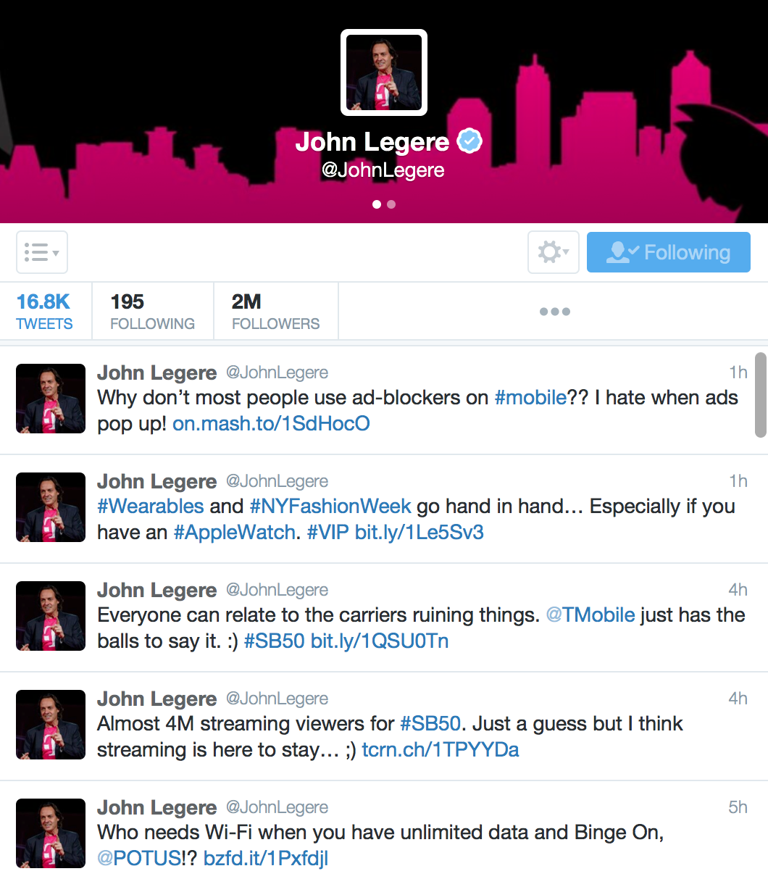

Disruption to Enterprise IT is Already Here
From the outsiders
From the uber insider
Notes:
By developing their own tools, frameworks and platforms
Google built Kubernetes, their own build server,
Netflix pioneered Netflix OSS, Chaos Monkey, a huge array of monitoring tools
Amazon productized the internal platform for their online retailer. That public cloud product line is now bigger than their retail arm.
They are the original Cloud Natives
John J. Legere is an American businessman who is the chief executive officer and president of T-Mobile
Openly against Ads
Pro IOT
Admits mistakes – wants change
Wants streaming!
Wants Data to be replacement for Wifi – why not?

Slide 5
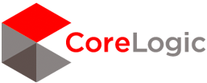


Fortune 500 Companies are Using Cloud Native Deployment Models
“I said to my vendors, I don’t want five years ago. I want five years from now.
“Two people built an app and got it into the App Store in five weeks”
“The adopters we speak to today, like GE, HP, Equinix, PayPal, Capital One, Goldman Sachs, Airbnb, Medallia, Square, and Xoom say that microservices are well worth the tradeoffs.”
Notes:
We’re seeing companies like like Lockheed Martin, BMW and Philips that are incubating cloud-native design in their organizations. These companies are shipping apps to production.
Source: WSJ http://blogs.wsj.com/cio/2015/10/05/innovate-or-die-the-rise-of-microservices/
Antonio Melo, Humana, CF Summit 2015

Slide 6

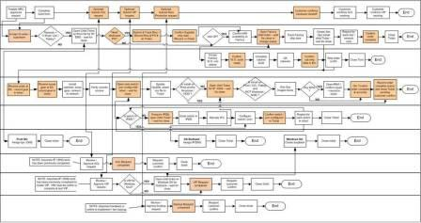
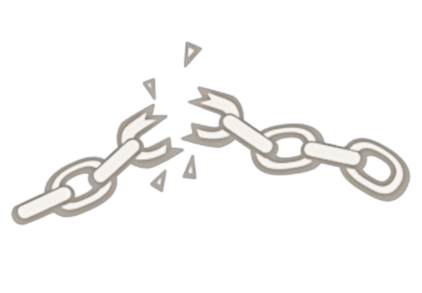

Monolithic Architectures Drive Complex Manual Deployment and Water Fall Release Cycles
Developer
Can you deliver full CI/CD for every major app in your portfolio today, or are you doing 75+ step manual deployments?
Operator
Notes:
We’re working with customers like Comcast and Lockheed Martin who have been struggling to ship software faster. Both in terms of new projects and implementing these modern, DevOps-friendly environments that can handle real continuous delivery.
If you’re doing big project with ‘agile waterfall’ where you use agile development with weekly sprints but have a huge manual process to actually ship every 3-9months.
Disconnect between dev and ops. Throw the code over the wall
… and do it all over again from Dev → Test → Prod on any infrastructure

Slide 7
WHAT
Notes:
Now I’d love to open this up for discussion.

Slide 8

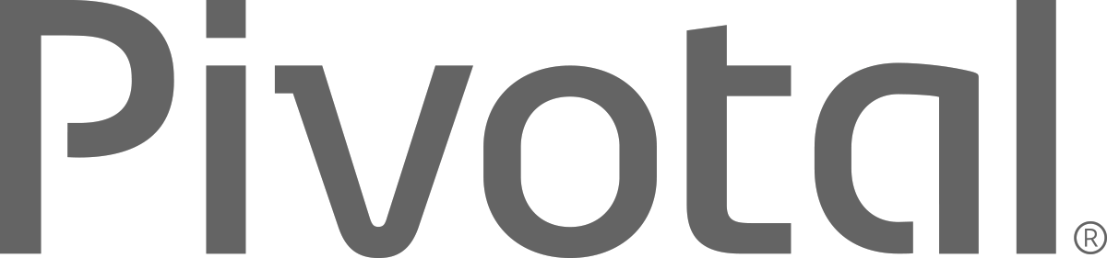
What is Cloud Native?
A term that recognizes that getting software to work in the cloud requires a broad set of components that work together.
It requires an architecture that departs from traditional enterprise application design, such as ‘Microservices’
It requires a Cloud Native platform
Notes:
http://www.informationweek.com/cloud/platform-as-a-service/cloud-native-what-it-means-why-it-matters/d/d-id/1321539

Slide 9
What are Microservices?
If every service has to be updated in concert, it’s not loosely coupled!
Loosely coupled service oriented architecture with bounded contexts
If you have to know about surrounding services you don’t have a bounded context.
Notes:
I presume you’re all familiar with microservices and cloud-native, but quickly, here’s an introduction. They’re loosely coupled, service oriented architecture with bounded contexts.
Because each service can be updated independently, your teams can work in parallel. Because each service is isolated, it’s much easier to automate your testing.

Slide 10
Trend Toward New Lightweight Architecture
Microservices addressing speed to market and cloud scale
MONOLITHIC/LAYERED
MICROSERVICES
Notes:
Enterprise companies in finance and telco industries are embracing microservice and cloud-native models.
There are new architectures emerging atop these lightweight app servers to address the scale, speed and safety: new ways of tackling cloud scale and speed to market. Microservices has emerged from the internet giants as such an alternative: a change in culture, organization structure and technology that allows teams to work more independently, and increase velocity. It’s a key part of cloud-native applications, which we’ll talk about shortly.
Microservices are both a cultural and organizational change as a change in how we design and implement systems.

Slide 11
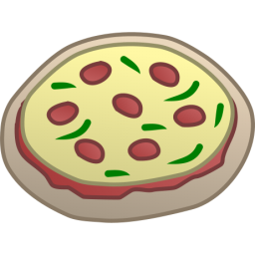
One-Size-Fits-All Methodologies are an Anti-Pattern to the Business
X
HTML
Java
Script
MVC
X
Service
Service
Data Access
Monolithic Application
> 2 Pizzas Per Project = Too Many Pizzas

Slide 12



Agile Disruptive Companies use Non-traditional, Modular Approaches to Software Systems
Microservice based architecture
Relational
DB
Key/Value
Store
AQMP
…..........
Shared
DB
REST
REST
DB Service
Caching Service
Messaging Service
Two Pizzas Per Microservice = Manageable!
Notes:
Agile, Disruptive Companies Use Non-traditional, Modular Approaches to Software Systems

Slide 13
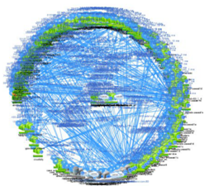
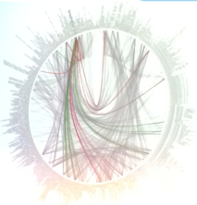
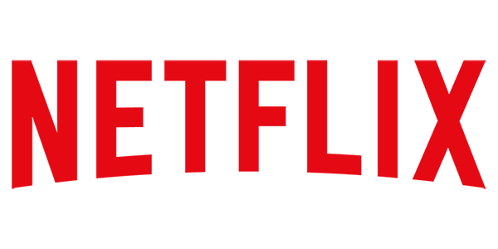
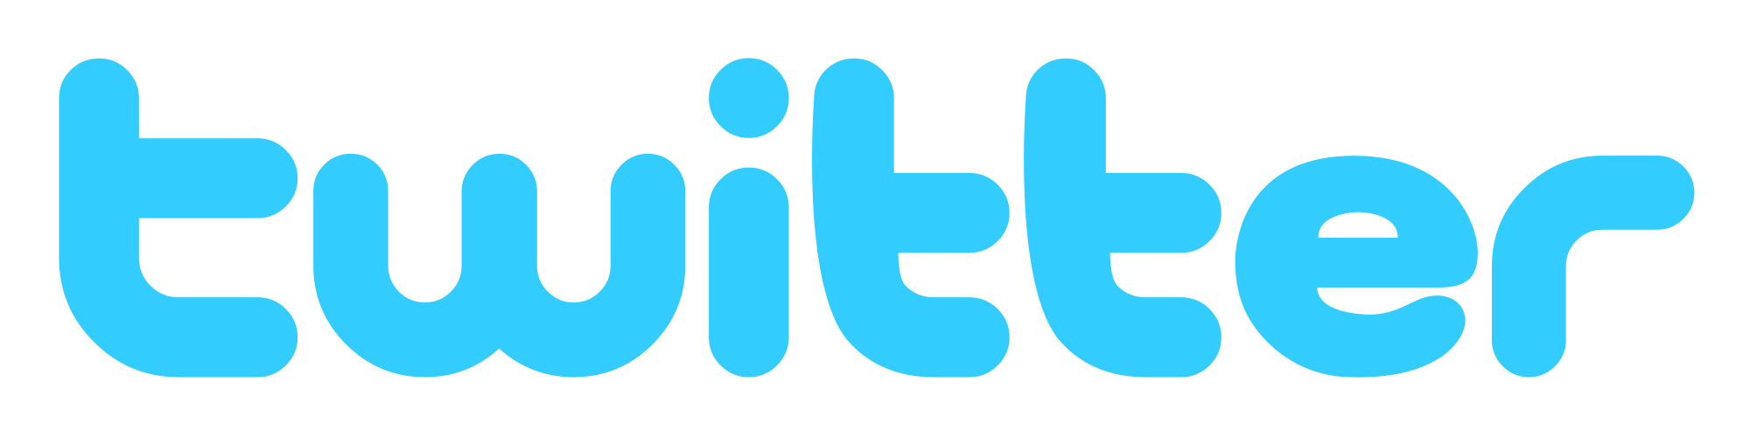
However… Microservices are Hard
Notes:
Distributed systems are HARD
Configuration Management
Service Registration & Discovery
Routing & Load Balancing
Fault Tolerance (Circuit Breakers)
Monitoring
Concurrent API Aggregation & Transformation
----- Meeting Notes (2/24/16 13:58) -----
Dependency Map

Slide 14
HOW
Notes:
Now I’d love to open this up for discussion.

Slide 15



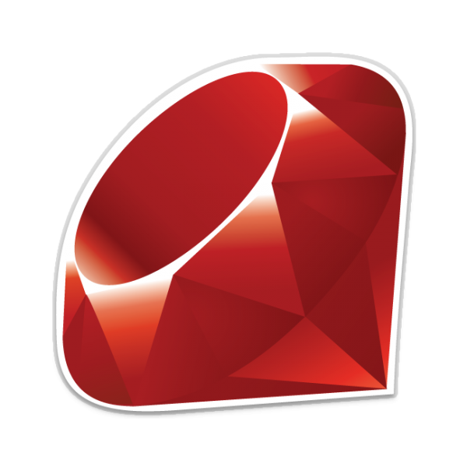






Cloud Native Platforms and Contracts
Culture
Framework
Tools
Application Framework
Netflix OSS, Spring, .NET, Ruby
Python, and more...
App Dev
Contract: 12 Factor App
Elastic Container Runtime
Pivotal
Cloud Foundry
PaaS Dev & Ops
Contract: BOSH Release
Infrastructure Automation
bosh.io
IT Ops
Contract: Cloud Provider Interface
Azure

Slide 16

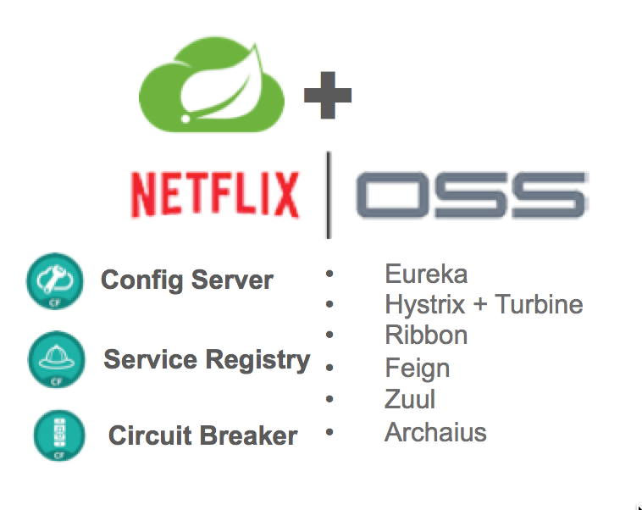

Application Framework
Spring Cloud
Spring Boot
Dev
Spring Boot
From 0 to app in < 5 min
Spring Boot provides
A single point of focus (as opposed to large collection of spring-* projects)
Prebuild “starters”
Common non-functional requirements for a “real” application
Exposes a lot of useful features by default
Gets out of the way quickly if you want to change defaults
Notes:
This month alone, there were over 1.6m downloads, 8m YTD, growing at 10% m/o/m key new projects. Why? because developers love Boot - It’s zero config, super lightweight, runtime ideal for single purpose single process applications aka microservices. With Boot you can go from 0 to app in <5minutes
But remember the concept of fragile infrastructure and designing for failure? How do you wire up all these little processes into a cohesive app that works even when things go wrong?
Luckily Netflix has solved some of these problems at web scale ( their OSS stack is great, but not so easy to use). Swe took that core functionality and built spring cloud. All the power of eureka, hysterix, and config server built as spring modules. As easy adding an annotation and secure for the enteprrise
So awesome even netflix is using it now now we have the app devs able to run super fast and make lots of microservices and tie them together to make amazing apps with spring boot and cloud
But this actually created a huge ops problem …..

Slide 17


D e m o
Notes:
Go to start.spring.io and create an app
Discuss the Gradle/Maven file dependencies
Show Fortune Teller

Slide 18



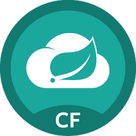
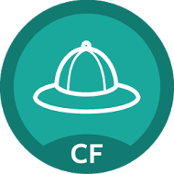
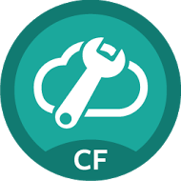

Spring Cloud Services
Rich, production ready library based on Netflix OSS for
cloud native components, security and management.
Cloud
Services
Service
Registry
Config
Server
Circuit
Breaker
core
boot
Dev
Ops + Platform
Notes:
So if you’re interested in incubating microservices, how do you get there? These designs there were until recently, exclusively the domain of the Googles, eBbays, and Twitters, have now gone mainstream. How can you build a microservices application today at your organization? Well, you’ll want to build it using your existing developers' skills.
If you’re a Java shop, there are some great OSS tools available. Spring is #1 Enterprise Java App Dev Framework. Everything is open source.
The Spring Cloud adds distributed system components for configuration management, service discovery, circuit breakers and more.
It’s platform aware and provides an integrated spectrum of opinions. Convention over configuration .
We’ve packaged these components up so your developers can run them on the platform as attachable backing services. It’s built into our Spring Cloud tile.
Finally, Spring Boot adds Rails-like packaging and lightweight app server so your devs

Slide 19





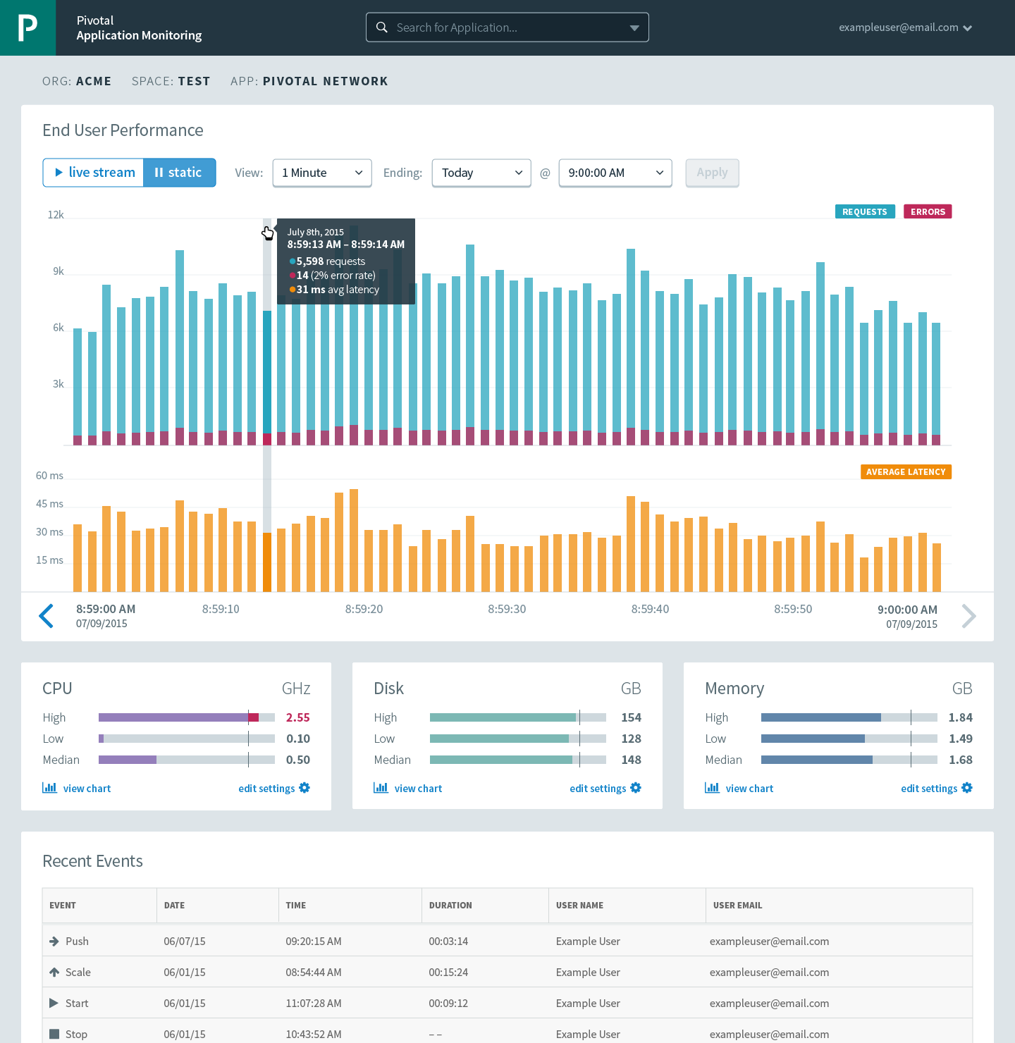




Runtime Platform
Dev
IT Ops
Cloud Foundry
Mobile Services
Centralized Log Management
Networking & Load Balancing
Auto-Scaling
APM & Tracing
APPLICATION
Health management
Full Stack CI/CD platform
Notes:
So Spring Boot/Cloud meant create apps fast – But Dev & Ops is asking Day2 questions -
How do you do logging, routing, apm, scaling, and lifecycle management of all these apps.
Enter CF Runtime
best in class container management
integrated agentless logging
with APM
auto scaling
Effortless runtime with minimum human operational overhead. We run 1000s of apps and 10,000s containers on PWS with 6 guys.
But we realized that stopping there wasn't enough

Slide 20

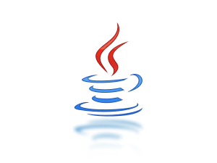


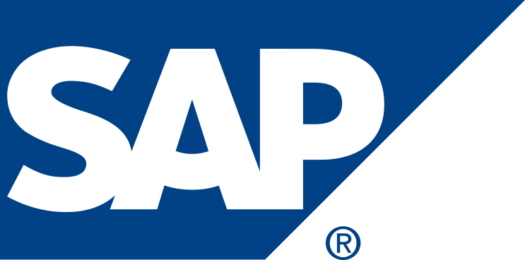
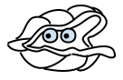
APPLICATION
Infrastructure as code
Security & Isolation
Language Agnostic
Integrated Data Services
Growing ISV & Partner Ecosystem
Cloud Agnostic
Day 2 Operations
Infrastructure Automation
IT Ops
BOSH
Infrastructure
Azure
IT Ops
Notes:
We needed to orchestrate the infrastructure to support this runtime. CF tells the infrastructure what to do and has a common API to support various infra types – AWS, vSphere, Openstack, Azure
When things break (and they will), the notion of self healing kicks in. There is no calling IT Ops, opening tickets, adding new VM’s, creating VM templates, upgrading Operations system, all that is automated and CF takes care of that.
And that gives you - Zero downtime, No maintenance windows
No managing OS upgrades, No managing VM’s
An amazing Operations savings story. What can you do with that time and labor savings ?

Slide 21
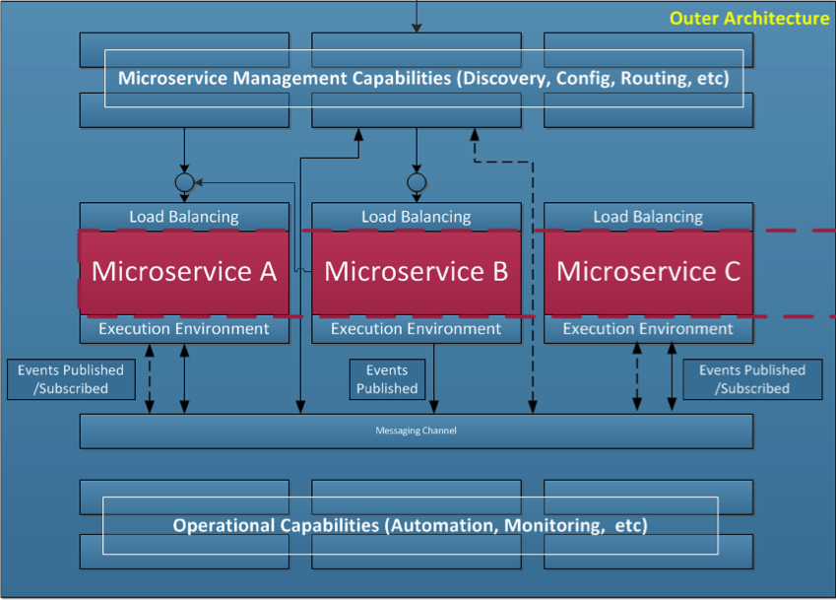
Cloud Native Platforms Provide the Outer Architecture
“The hardest part of building microservices is in the outer architecture (All of the blue boxed components).”
Inner
Architecture
“Easiest part of the microservices is in the inner architecture. The architecture of an individual microservice.”
Notes:
This slide is from T-Mobile – it is from a POC under Steve Hull’s group evaluating microservice architectures on public cloud infrastructure.

Slide 22
Ops Loop
8. Upgrade
Dev Loop
1. Provision
6. Run
1. Design
7. Recover
2. Authorize
Biz
6. Scale
5. Deploy
2. Build
3. Integrate
3. Configure
5. Audit
4. Monitor
Notes:
Why are you enabling continuous development?
The goal is to speed up your team’s clock cycle.
If your developers are self service, if they’re spending less time on operations, then you can increase your clock speed.

Slide 23
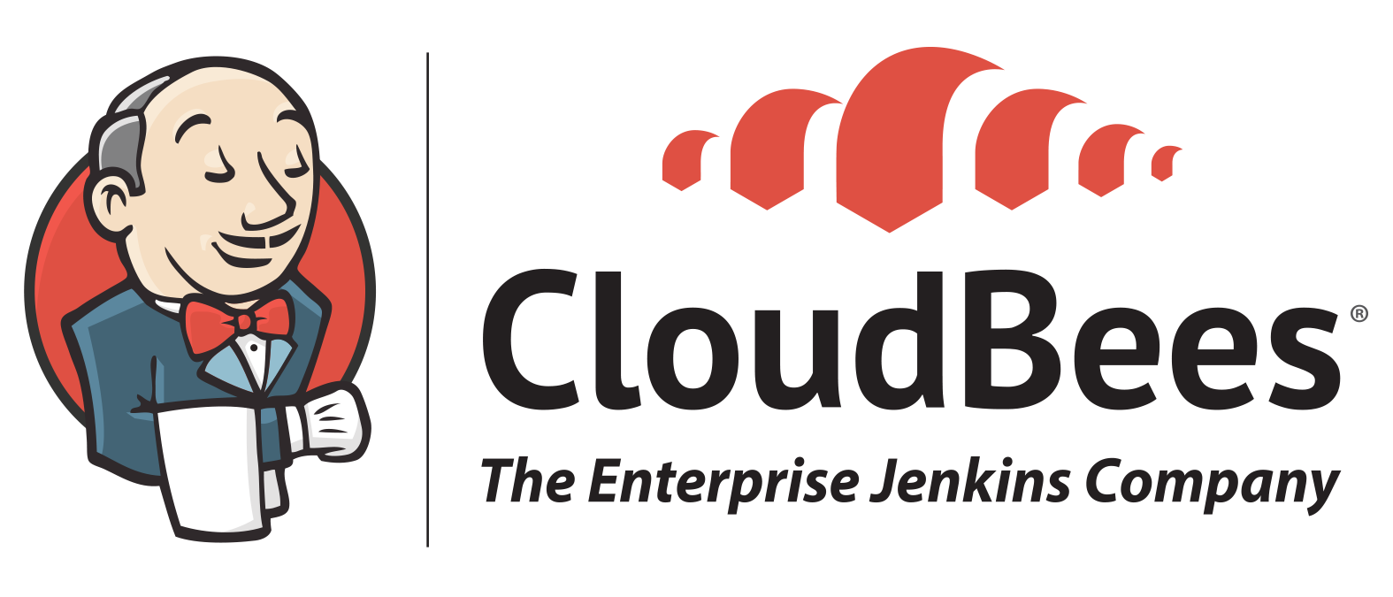
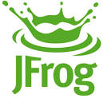
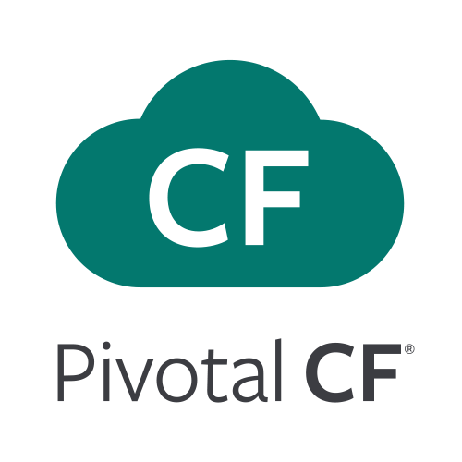
Application Lifecycle Management: CI/CD Delivery High Quality Software, Faster and Continuously From Idea to Production
AUTOMATION.
Integrate tools and automate processes from testing to builds and deployment
SPEED.
Release more frequently with smaller bits will reduce complexity and improve time-to-market
QUALITY.
Reduce feedback loop using test-driven development to surface problems sooner and be responsive
AGILITY.
Push updates on regular basis with no downtime to improve customer experience and time to market
Commit Code Change
Automate Build & Test
(Unit Test, Static Code Analysis)
Store Binaries & Build Artifacts
Automated Integration Testing
Acceptance, Performance & Load
Zero Downtime Upgrade to Production
Build Pipeline Operations
Tool Chain
Gitlab
Jenkins
Development
Test + UAT + Staging
Production
Problem: Customers want to use Git distributed source code control system, yet maintain on-premise control of it
Problem: Current application delivery pipeline is manual and error-prone, and lacks automation, scale, speed, transparency, compliance and reliability.
Problem: Development requires management of binary artifacts to incorporate 3rd party components and track application binary artifacts
Develop, test, QA and production on the same platform. Simple, developer friendly commands and APIs. Operational benefits for every app. Built-in ecosystem services. Deploy, operate and scale on any IAAS
Solution: Distributed revision control and source code management. Collaborative software development
Solution: Build and test software projects continuously and incrementally. Hundreds of compatible plugins
Solution: Share binaries and manage distributions. Manage artifact lifecycle. Avoid license violations

Slide 24
Find your Spot on the Cloud Native Maturity Model
Cloud Native
Microservices architecture
API-first design
Fault-tolerant and resilient design
Cloud-agnostic runtime implementation
Bundled metrics and monitoring
Proactive failure testing
Cloud Resilient
Cloud Friendly
12 Factor App methodology
Horizontally scalable
Leverages platform for high availability
Cloud Ready
No permanent disk access
Self-contained application
Platform-managed ports and networking
Consumes platform-managed backing services
Notes:
Cloud Ready: No mounting file systems!
Cloud Friendly: Scalable, platform provides HA
Cloud Resilient: Cloud Agnostic, Fault Tolerant
Cloud Native: microservices + API first

Slide 25
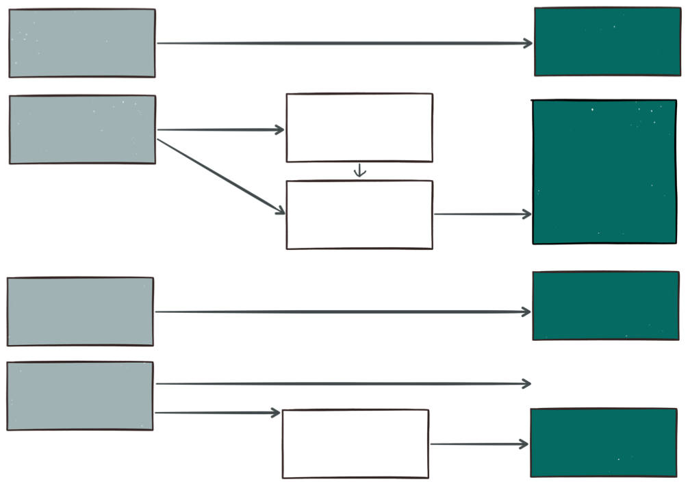
Chart Your Transformation Path
JAVA
(BUILDPACK)
SPRING
FULL PROFILE
JEE
3rd PARTY
(BUILDPACKS)
MODERNIZE
WEB PROFILE
TYPE OF APPLICATION
BUILDPACK OR PCF FEATURE
.NET
(DIEGO CELL)
.NET
Ruby, NodeJS
PHP, Python
GO … AND MORE
OTHER…
DOCKER
DIEGO
(GARDEN LINUX)

Slide 26
The Cloud Native Applications Journey
And How Pivotal Can Help
GREENFIELD, CLOUD NATIVE APP DEVELOPMENT
Your People Paired With Us in Our Lab Building Modern Software from the Ground Up
PIVOTAL LABS ENGAGEMENT
APPS REPLATFORMING
APPS MODERNIZATION
OPS & ORG TRANSFORMATION
RUNS ON LEGACY IT
RUNS ON PIVOTAL CLOUD FOUNDRY
RUNS WELL ON PIVOTAL CLOUD FOUNDRY
RUNS GREAT ON PIVOTAL CLOUD FOUNDRY
Your Existing Apps Running on Current-Era Stacks Supported by Time-Tested People and Process
Suitable Apps Moved to PCF with Minimal Code Change; Better Ops Thanks to Platform Automation
Legacy Apps Refactored Using 12-Factor Principles and Modern Software Process (TDD, CI/CD), Optimized for PCF
Cross-Functional Teams Delivering Continuous Software Updates Into PCF End-to-End Through Modern Principles

Slide 27
B r e a k
Notes:
(bold moves)
2015 – This is..
The year where we see a level of adoption of our products and services that propels us to becoming an ipo-worthy company
This is..the year where our great vision becomes a reality in production environments at the most important companies and organizations in the world.
This is the year that we show and teach our customers and partners the power and opportunity that building great software brings.

